Slide 1

Introduction to Cybersecurity: Foundations and Mental Models
University of the Witwatersrand | COMS4064A

Slide 2
Security vs. Other CS Disciplines
Traditional Dev Though
Security-focused Dev Thought
"Does it work?"
"Does it work... even when someone is trying to break it?"
Focus on functionality
Adversarial thinking required
Optimise for performance
Your code has an intelligent opponent
Assume silly but mostly cooperative users
They have time, motivation, and creativity
Success once = success always
They only need to win once

Slide 3

Thinking Like an Attacker
The Security Mindset
Consider a hotel room door lock. A normal person asks: "Does my key work?" A security-minded person asks entirely different questions:
Can I pick the lock?
Can I copy someone else's key?
Physical manipulation of the mechanism
Social engineering or theft
Can I trick staff into giving me a key?
Can I just climb through the window?
Exploiting trust relationships
Alternative attack vectors

Slide 4
Today's Roadmap
01
02
03
Linux Foundations
Finding Information
CIA Triad
The essential tools for security practitioners
Staying current in a rapidly evolving field
The fundamental goals of cybersecurity
04
05
06
Risk & Controls
Threat Modelling
Kill Chain
Strategic approaches to managing threats
Systematic framework for security analysis
Understanding the attacker's playbook

Slide 5


CHAPTER 1
Linux

Slide 6




The Operating System of Security
Most security tools and infrastructure run on Linux. Understanding why this matters is crucial for any security practitioner.
Kali Linux
Security Onion
The industry-standard penetration testing distribution, pre-loaded with hundreds of security tools.
Network security monitoring platform for intrusion detection, log management, and enterprise security monitoring.
Cloud Infrastructure
Analysis Sandboxes
Most cloud containers and servers run Linux variants, making command-line proficiency essential for cloud security.
Malware analysis environments rely on Linux for safe investigation and reverse engineering of threats.

Slide 7
Why Not Just Click?
The Scenario
Command Line Approach
You need to find all failed login attempts in a 2GB log file to investigate a potential breach.
grep "Failed password" /var/log/auth.log > failed_logins.txt
GUI Approach
Open file manager
Key Advantages
Wait for file to load...
Automation at scale
Application crashes
Speed for large datasets
Give up
Scriptable and repeatable
Time wasted: 10+ minutes
Low memory overhead
Works remotely over SSH

Slide 8
Essential Linux Commands
Navigation & Inspection
Moving Around
Reading Files
cat file.txt — Dump entire file to screen
pwd — Where am I? (print working directory)
less file.txt — Paginate with search (press / to search)
ls — What's here? (list files and folders)
head -n 20 — First 20 lines
cd /path/to/directory — Go there (change directory)
tail -f — Last lines, live updates (perfect for logs)
ls *.log — Show only log files (pattern matching)
grep "error" file.txt — Find specific lines

Slide 9
Who Can Do What?
Every file in Linux has permissions that control read, write, and execute access. The command ls -la reveals these permissions:
Example Output
Privilege escalation attacks frequently exploit incorrect file permissions. A common scenario:
-rwxr-xr-x
Owner: rwx (read, write, execute)
Sensitive configuration file has world-readable permissions
Group: r-x (read, execute only)
Attacker reads database credentials
Others: r-x (read, execute only)
Lateral movement to database server
Game over
Key Commands
chmod — Change permissions
chown — Change ownership
sudo — Execute as superuser

Slide 10
Seeing Network Activity
Essential Networking Commands
ip addr
ss -tulpn
Display all network interfaces and their IP addresses. Essential for identifying your system's network configuration.
Show what ports your system is listening on. Critical for detecting unauthorised services or backdoors.
ip addr show
ss -tulpn | grep LISTEN
curl
ping
Make web requests from the command line. Useful for testing APIs and investigating suspicious URLs safely.
Test network connectivity to a host. Basic but essential for diagnosing network issues and reachability.
curl https://example.com
ping -c 4 google.com
Security Use Case
Imagine you suspect malware on a system. Running ss -tulpn reveals an unexpected process listening on port 4444 — a common Metasploit backdoor port. Is malware opening a backdoor?

Slide 11

The Open Source Debate
Many Eyes vs Many Exploits
Linus's Law
"Open source is dangerous because attackers can find exploits easily"
"Given enough eyeballs, all bugs are shallow"
Open source is safer because anyone can audit the code. Transparency enables community-driven security improvements and faster vulnerability discovery.
Public code gives adversaries a roadmap. Malicious actors can study the source systematically to discover vulnerabilities before defenders.
Reality: Visibility changes the dynamics of discovery, but not the quantity of bugs. The crucial factor becomes time-to-fix versus time-to-exploit. Heartbleed existed in OpenSSL for two years despite being open source—scrutiny requires competent eyes, not just many eyes.
Key insight: Open source transparency is valuable, but without adequate resources for security audits and rapid patching, visibility alone doesn't guarantee security.

Slide 12
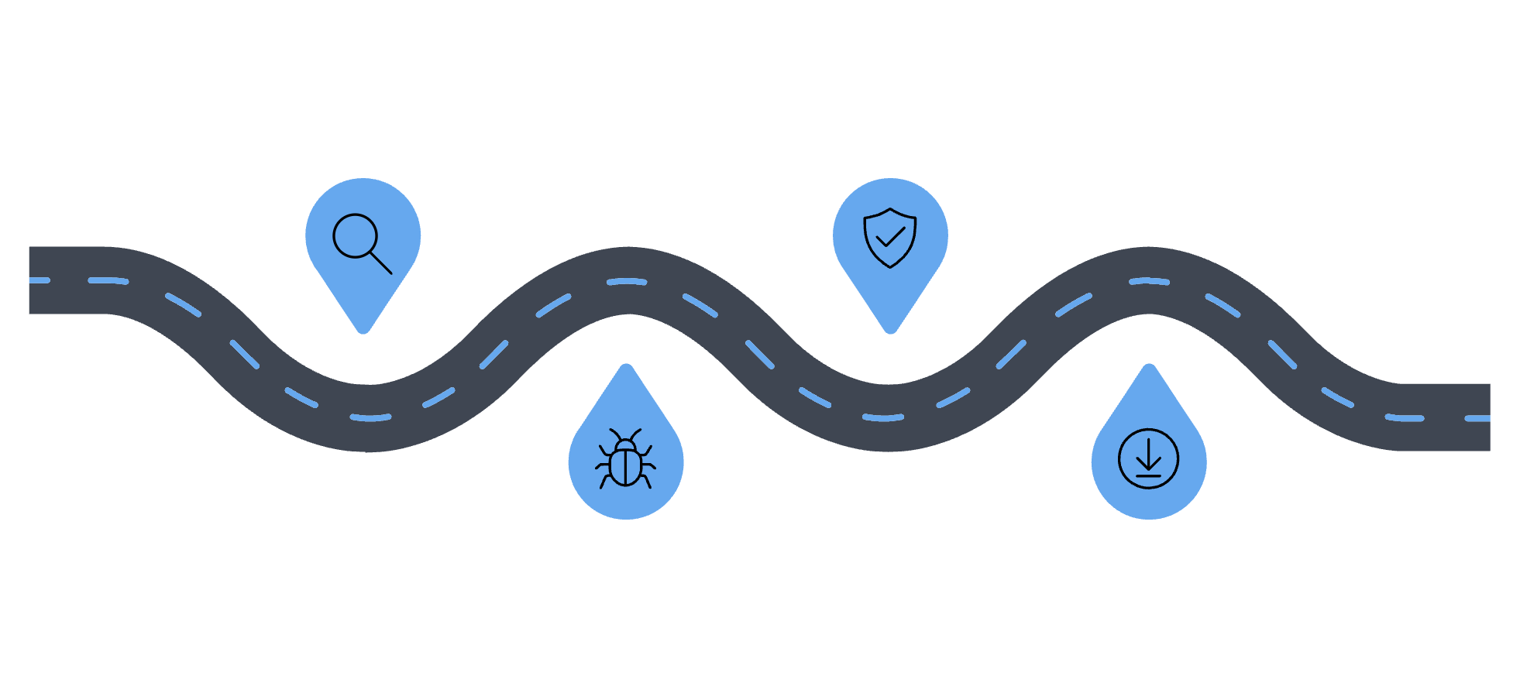




Patch Gap
The Critical Window
Discovery
Patch Released
Open source advantage: Fixes are published transparently, and the community can verify patches meet security standards.
Vulnerability identified publicly
Fix published by maintainers
Open source challenge: Everyone sees the vulnerability when it's announced, creating a race between defenders patching and attackers exploiting.
Exploit Available
Patch Applied
Average time to exploit: 5.5 days after disclosure
Average time to patch: 38 days
Systems updated and remediated
Proof-of-concept or exploit appears
60% of breaches involve vulnerabilities for which patches were available but not applied
The vulnerability exists in your code, not just in the CVE database.

Slide 13

CHAPTER 2
Staying Current
New vulnerabilities are discovered daily. In 2025 alone, approximately 48,185 CVEs were published — that's roughly 130 per day.

Slide 14

Understanding CVE Identifiers
What is CVE?
Why It Matters
CVE = Common Vulnerabilities and Exposures
CVE IDs provide a universal reference system that enables:
A standardised identifier for publicly known security flaws, used globally by vendors, researchers, and security tools.
Consistent communication across organisations
Automated vulnerability scanning
Patch management tracking
Format Breakdown
Threat intelligence sharing
CVE-YEAR-NUMBER
Compliance reporting
Example: CVE-2021-44228 (Log4j)
Primary source: www.cve.org
2021 — Year discovered/published
44228 — Unique sequential number

Slide 15






Getting Details and Severity
National Vulnerability Database (NVD)
The NVD at nvd.nist.gov enriches CVE records with critical context and scoring.
CVSS Scoring
Affected Software
References
Severity ratings from 0-10 using the Common Vulnerability Scoring System
CPE (Common Platform Enumeration) strings identifying vulnerable products and versions
Links to vendor patches, advisories, and technical analysis
CVSS Severity Ranges
0.0-3.9
Low
Minimal impact, often requires user interaction
4.0-6.9
Medium
Moderate impact, some exploitation complexity
7.0-8.9
High
Significant impact, easier to exploit
9.0-10.0
Critical
Severe impact, often remotely exploitable

Slide 16
Trust but Verify Sources
Always Go to the Source
Why Primary Sources Matter
When investigating vulnerabilities, vendor advisories should be your first stop:
News articles often:
Sensationalise for clicks
Microsoft flaw? → Microsoft Security Response Centre
Omit critical technical details needed for mitigation
Cisco bug? → Cisco Security Advisories
Get facts wrong or misunderstand severity
WordPress plugin? → WordPress.org security page
Delay updates compared to vendor advisories
Open source project? → Project's GitHub security tab

Slide 17

CHAPTER 3
The CIA Triad
What does "secure" actually mean?

Slide 18
Reframing the Question
Wrong Question
Better Questions
"Is this system secure?"
"Is it confidential against network attackers?"
"Can integrity be violated by insiders?"
"Will it stay available under DDoS attack?"
"What are we protecting, and from whom?"

Slide 19






The Three Pillars of CIA
Integrity
Preventing tampering. Data remains accurate and unmodified by unauthorised parties.
Confidentiality
Keeping secrets secret. Information accessible only to authorised parties.
Availability
Ensuring access. Authorised users can access resources when needed.

Slide 20
Confidentiality
Keeping Secrets Secret
Definition
Technical Controls
Information is accessible only to authorised parties. Unauthorised disclosure is prevented through technical and administrative controls.
Encryption
Real Breach: Zoom (2020)
AES-256, TLS/SSL for data at rest and in transit
Zoom meeting IDs were predictable, allowing attackers to guess valid IDs and "Zoom-bomb" private meetings.
Access Control Lists
Impact: Privacy violations, corporate espionage risk
ACLs defining who can access what resources
Fix: Randomised IDs, waiting rooms, passwords
Multi-Factor Authentication
MFA requiring multiple proof factors
Example: WhatsApp
End-to-end encryption means even WhatsApp's servers cannot read your messages — only sender and recipient hold the keys.

Slide 21
Integrity
Preventing Tampering
Definition
Technical Controls
Data remains accurate and unmodified by unauthorised parties. Any tampering is detectable and preventable.
Cryptographic Hashing
SHA-256: Any change produces completely different hash
Real Attack Scenario
Attacker intercepts a bank transaction:
Digital Signatures
Original: Transfer £100 to Account A
Cryptographically prove author and detect modifications
Modified: Transfer £10,000 to Account A
Impact: Financial loss, loss of trust in banking system
Write-Once Storage
Immutable logs and audit trails
Version Control
Git and similar systems tracking all changes
Example in Practice
Software downloads include hash values. Compare the downloaded file's hash against the published hash — if they differ, the file was tampered with or corrupted.

Slide 22
Availability
Ensuring Access When Needed
Definition: Authorised users can access resources when required. Services remain operational despite attacks or failures.
Real Attack: 2016 Dyn DDoS (Mirai Botnet)
The Mirai botnet leveraged hundreds of thousands of compromised IoT devices to launch a massive distributed denial-of-service attack against Dyn, a major DNS provider. The attack took down Twitter, Netflix, Reddit, and other major services for hours.
Impact
Technical Controls
Lost revenue from service downtime
Redundancy: Multiple servers, data centres, network paths
Angry customers and damaged reputation
Load Balancing: Distribute traffic across resources
SLA (Service Level Agreement) violations
DDoS Mitigation: Cloudflare, Akamai, AWS Shield
Potential regulatory fines
Rate Limiting: Prevent resource exhaustion
Offline Backups: Ransomware defence
Example: CDNs (Content Delivery Networks) cache content globally, so even if one region fails, users can still access the service from another location.

Slide 23

CIA Triad Trade-offs
You Can't Always Have All Three
Security decisions involve balancing competing priorities. Maximising one aspect often means compromising another.
Confidentiality vs. Availability
Maximum confidentiality = air-gapped system (completely isolated from networks). Result: Not remotely available to legitimate users.
Integrity vs. Availability
Blockchain = extremely high integrity through distributed consensus. Result: Slow write operations, reduced availability for high-throughput applications.
Discussion Question: "What should a hospital prioritise? What about a bank? How do their threat models differ?"

Slide 24






Return to CVSS
Example: CVE-2023-34362 (MOVEit)
CVSS: AV:N/AC:L/PR:N/UI:N/S:U/C:H/I:H/A:H -> Score: 9.8 Critical
Attack Vector (AV)
Attack Complexity (AC)
Privileges Required (PR)
Network (N) scores highest—remotely exploitable. Adjacent (A), Local (L), Physical (P) score progressively lower.
Low (L) means easy exploitation. High (H) requires special conditions beyond attacker control.
None (N) is worst—no authentication needed. Low (L) or High (H) privileges required score lower.
User Interaction (UI)
Scope (S)
Impact: C/I/A
None (N) means automatic exploitation. Required (R) means victim must be tricked.
Changed (C) affects resources beyond security scope. Unchanged (U) stays within boundaries.
Confidentiality, Integrity, Availability rated None/Low/High based on data affected.
CVSS measures severity, not risk!

Slide 25
ACTIVITY
Real Vulnerability Analysis
HeartBleed Deep Dive
Let's investigate CVE-2014-0160 (HeartBleed) together!
1
Find the CVE Record
2
Identify the CVSS Score
3
Read the Description
Navigate to cve.org and search for CVE-2014-0160
What severity rating has been assigned? Is it Low, Medium, High, or Critical?
What type of vulnerability is this? What software is affected?

Slide 26


Case Study: Heartbleed
The Bug: Buffer over-read in OpenSSL's TLS heartbeat extension. A missing bounds check allowed reading 64KB of memory per request—potentially leaking private keys, passwords, and session cookies.
CVE-2014-0160
Impact: 17% of all secure web servers affected globally. The irony: a security library compromising security.
Timeline: Introduced in March 2012, discovered April 2014—over two years of exposure.
// Vulnerable code (simplified) memcpy(bp, pl, payload); // No check: is payload <= actual_length?
OpenSSL was maintained by a handful of volunteers securing most of the internet's encrypted traffic.

Slide 27

CHAPTER 4
Threat Modelling
Asset, Adversary, Mechanism

Slide 28
From Vague to Precise
Before Threat Modelling
After Threat Modelling
"We need to secure our chat app"
"We need to prevent network attackers from reading message content using end-to-end encryption"
This statement is too vague to act upon. What does "secure" mean? Against whom? Using what defences?
This is specific, actionable, and testable.
Threat Modelling Framework (MIT 6.858)
01
02
03
Asset & Policy
Adversary
Mechanism
What are we protecting? What's the rule or requirement?
Who's attacking? What capabilities do they have? What are their limitations?
How do we defend? What technical controls enforce our policy against this adversary?

Slide 29
Modelling a Secure Chat App
Let's analyse a messaging application (similar to Signal or WhatsApp) using systematic threat modelling.
Confidentiality of Messages
Integrity of Messages
Availability of Service
Preventing eavesdropping on message content
Ensuring messages aren't tampered with in transit
Keeping the messaging service operational

Slide 30
Threat Model 1: Confidentiality
Protecting Message Secrecy
Goal
Adversary: Network Attacker
Keep message content secret from everyone except sender and recipient.
Examples: WiFi owner, ISP, government surveillance
Capabilities:
Asset
Can see all packets on the wire
The text and media content of messages
Can capture and analyse traffic
Policy
Can record encrypted data for later analysis
Only sender and recipient may read the message. Even the service provider cannot access content.
Cannot: Break strong encryption (yet)
Real scenario: Coffee shop WiFi owner running Wireshark to capture traffic

Slide 31
Threat Model 2: Integrity
Preventing Message Tampering
Goal
Adversary: Malicious Relay Server
Ensure messages aren't modified during transmission.
Examples: Compromised infrastructure, rogue employee, state-level tampering
Asset
Capabilities:
Message content accuracy
Can see messages (if not encrypted)
Policy
Can modify message content
Received message must be identical to sent message. Any modification must be detected.
Can delete or duplicate messages
Cannot: Break cryptographic signatures
Scenario: "What if the server changes 'Meet at 2pm' to 'Meet at 4pm'?"

Slide 32
Threat Model 3: Availability
Keeping Service Operational
Goal
Adversary: DDoS Attacker with Botnet
Ensure users can send and receive messages reliably.
Capabilities:
Asset
Commands 100,000+ infected IoT devices
The messaging service capability
Generates massive fake traffic floods
Overwhelms server capacity
Policy
Doesn't need to "hack" — just floods with requests
Messages delivered within 2 seconds, 99.9% uptime guaranteed.

Slide 33
How would you preserve confidentiality, integrity, and availability in the messaging app?

Slide 34



Confidentiality
End-to-End Encryption Defence
Sender's Device
Network/Servers
Recipient's Device
Message encrypted using recipient's public key before leaving device
Encrypted gibberish in transit. Even service provider sees only scrambled data.
Decrypted using recipient's private key. Only here does plaintext exist.
Protocol Examples
Signal Protocol: Used by Signal, WhatsApp, Facebook Messenger
TLS 1.3: Secures web traffic
PGP/GPG: Email encryption

Slide 35




Integrity
Cryptographic Signatures Defence
Mechanism: Message Authentication Codes (HMAC) or Digital Signatures
Transmission
Sender Signs
Message and signature travel together through potentially hostile network infrastructure.
Sender creates cryptographic signature using their private key, attaching it to the message.
Detection
Recipient Verifies
If message was modified, signature verification fails. App rejects tampered message.
Recipient uses sender's public key to verify signature matches message content.

Slide 36

Availability
Scale and Rate Limiting Defence
1
2
Rate Limiting
CAPTCHA Challenges
Maximum 10 requests per second per IP address. Exceeding this triggers temporary blocks.
Suspicious traffic patterns trigger human verification tests to filter bots from legitimate users.
3
4
CDN Traffic Absorption
Auto-Scaling Infrastructure
Cloudflare, AWS Shield, or Akamai absorb and filter attack traffic before reaching origin servers.
Automatically provision additional server capacity during traffic spikes to maintain service levels.

Slide 37

When Security Fails
Understanding Failure Modes
Security fails when the Mechanism cannot enforce the Policy against the Adversary. Understanding failure modes helps us anticipate weaknesses and plan upgrades.
Weak Mechanism vs. Advanced Adversary
Example: AES-128 encryption (mechanism) vs. quantum computer (adversary) — current encryption may become breakable.
Overwhelmed Mechanism
Example: Rate limiting 1000 req/sec (mechanism) vs. distributed attack from 1 million IPs generating 10 req/sec each (adversary).
Bypassed Mechanism
Example: Physical door lock (mechanism) vs. lock-picking expert or someone who climbs through window (adversary).
This is why threat modelling is continuous, not one-time. Adversaries evolve, and mechanisms must adapt.

Slide 38

CHAPTER 5
Risk and Controls
How do we minimise the risk of mechanisms failing?

Slide 39
Risk Is Not Just "Danger"
Security Risk Formula
Four Ways to Handle Risk
Risk = Likelihood × Impact
Accept
Likelihood: Probability the threat occurs (0-100%)
Impact: Damage if it happens (£, downtime, reputation)
Do nothing — risk is low enough to tolerate
A high-impact, low-likelihood event might carry the same risk as a low-impact, high-likelihood event.
Avoid
Don't do the risky activity (e.g., don't store credit cards)
Mitigate
Reduce likelihood or impact (install firewall, train staff)
Transfer
Insurance or outsource to third-party vendor

Slide 40



Security Controls Overview
Three Types of Controls
Administrative Controls
Technical Controls
Physical Controls
Policies, procedures, and training that define expected behaviour.
Software and hardware mechanisms that enforce security automatically.
Real-world barriers that prevent unauthorised physical access.
Example: "Passwords must be 12+ characters with uppercase, lowercase, numbers, and symbols."
Example: System rejects passwords shorter than 12 characters, regardless of user intent.
Example: Locked server room, badge readers, biometric scanners, security cameras.
Strength: Consistent enforcement
Weakness: Can be expensive, may impact performance
Strength: Effective against local threats
Weakness: No protection against remote attacks
Strength: Low cost to implement
Weakness: Relies on human compliance
Controls have costs beyond money: usability friction, performance overhead, and maintenance burden.

Slide 41

Layering Control Types
Defence in Depth: Password Policy Example
Effective security uses multiple control types working together. If one layer fails, others still provide protection.
Physical Control
Technical Control
Keyboard has privacy shield preventing shoulder-surfing — protects password even when being typed.
Administrative Control
System automatically forces password change at 90 days — ensures compliance regardless of user memory.
Policy document states: "Change password every 90 days" — but relies on users remembering and complying.

Slide 42

Modern Security Architectures
Defence in Depth: The Castle Approach
Zero Trust: Never Trust, Always Verify
Don't rely on a single defence
Old model: "Inside the network = trusted"
Problem: Once attacker gets in, they're trusted too
Multiple layers force attackers to breach each one
Slows down attacks, increases detection opportunities
Zero Trust principles:
Layers: Moat → Outer wall → Inner wall → Guards → Vault
No implicit trust based on location
If attacker breaches one layer, they immediately face another.
Every request authenticated and authorised
Verify device health, user identity, context
Assume breach at all times
Least privilege access
Example: Employee on office WiFi still needs MFA to access database — location doesn't grant automatic trust.

Slide 43

CHAPTER 6
The Cyber Kill Chain
CIA and Threat Models help us think about our system, we can also define the adversaries attack strategy.

Slide 44
Thinking in Workflows, Not Lists
Defender Mindset
Attacker Mindset
"Did I patch everything? Did I update antivirus? Are passwords strong?"
"What's the path from outside the network to the database? How do I move laterally? Where are the weak points?"
A checklist approach that misses the bigger picture of how attacks actually unfold.
The Cyber Kill Chain (Lockheed Martin)
Models attacks as a sequence of stages, not isolated events
Breaking any stage will stop the attack
Helps prioritise defensive investments
Reveals dependencies in attacker workflows
Key insight: Attacks are graphs, not lists.

Slide 45
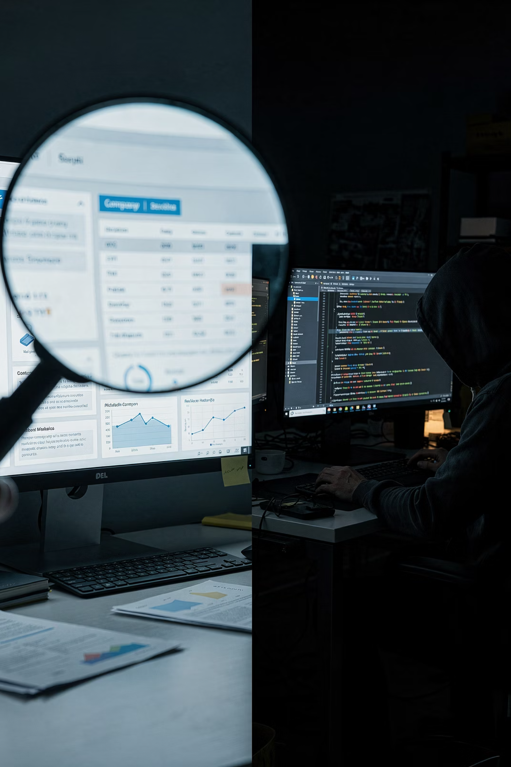
Kill Chain Stages 1-2
Reconnaissance & Weaponisation
Reconnaissance
Weaponisation
Attacker activities:
Attacker activities:
Google searches for company information
Create malicious PDF exploiting known CVE
LinkedIn for employee names, titles, email patterns
Clone legitimate website for phishing campaign
Shodan.io for exposed servers and services
Write malware customised to target environment
Port scanning with nmap
Test against antivirus to evade detection
WHOIS lookups, DNS enumeration
Defensive actions:
Defensive actions:
Minimise public information exposure
Patch vulnerabilities promptly
Monitor for reconnaissance (IDS alerts on scans)
User awareness training on phishing
Threat intelligence on attacker tools
Threat intelligence feeds

Slide 46
Kill Chain Stages 3-4
Delivery & Exploitation
Delivery
Exploitation
Attacker activities:
This is the "boom" moment where vulnerability is triggered.
Send phishing email with malicious attachment
Attacker activities:
Watering hole attack (compromise site victim visits)
User opens PDF → vulnerability triggered
USB drop in car park
Browser visits page → drive-by download
Malvertising (malicious advertisements)
Code execution achieved
Defensive actions:
Defensive actions:
Email filtering (spam, malware detection)
Endpoint protection (antivirus, EDR)
Web proxies blocking known-bad sites
Disable macros by default
USB port blocking policies
Memory protections (ASLR, DEP)
Ad blockers and script controls
Application sandboxing

Slide 47
Kill Chain Stage 5: Installation
Establishing Persistence
The attacker has achieved code execution. Now they need to ensure they can come back even after system reboots or detection attempts.
Attacker Activities
Defensive Actions
Install backdoor or rootkit
File integrity monitoring (detect unauthorised changes)
Add malicious scripts to startup locations
Monitor startup locations and scheduled tasks
Create scheduled tasks for regular execution
Application whitelisting (only approved software runs)
Modify system files and registries
Regular baseline audits
Install remote access trojans (RATs)
Endpoint Detection and Response (EDR)
Goal: Survive reboots, updates, and maintain long-term access

Slide 48
Kill Chain Stages 6-7
Command & Control and Actions on Objectives
Command & Control (C2)
Actions on Objectives
Attacker activities:
This is why they came — the attacker's end goal.
Malware connects to attacker's server
Attacker activities:
Receives instructions, exfiltrates data
Steal database (espionage)
Often uses DNS or HTTP to blend in with normal traffic
Encrypt files (ransomware)
Establishes encrypted channels
Delete backups
Defensive actions:
Pivot to other systems
Firewall outbound rules (default deny)
Install cryptominers
DNS monitoring for suspicious domains
Defensive actions:
Network traffic analysis
Network segmentation (limit lateral movement)
Data Loss Prevention (DLP)
Offline backups
Least privilege access
Incident response plan

Slide 49


CHAPTER 7
Law and Ethics
Legal and ethical boundaries
South African context

Slide 50


Authorisation Is Everything
Intent Is Not Enough
❌ Illegal Scenarios
✅ Legal Scenario
"I found a vulnerability in my university portal, so I accessed other students' grades to prove it's real"
"I obtained written permission, followed the defined scope, tested only authorised systems, and reported findings properly through the approved channel"
"I only scanned for open ports, I didn't exploit anything"
The law cares about authorisation, not intent. Good intentions don't prevent criminal prosecution.
"I meant to help, not harm"

Slide 51
South African Legal Framework
Cybercrimes Act 19 of 2020
POPIA (Protection of Personal Information Act)
Key offences:
Key requirements:
Unlawful access to computer systems
Unlawful interception of data
Must have lawful basis to process personal data
Data interference (modification/deletion)
Must implement adequate security measures
System interference (disruption of services)
Data subjects have rights to access and deletion
Possession of hacking tools with criminal intent
Breach notification requirements
Penalties: Heavy fines and/or imprisonment up to 15 years for serious offences
Security Research Implications
Testing without permission = criminal offence
Viewing user data during test = potential POPIA breach
Best practice: Proof of concept without touching real user data

Slide 52
Responsible Disclosure
If you discover a security vulnerability, follow this ethical disclosure process:
Day 0: Discovery
Day 90: Reasonable Time
Check for official disclosure policy on vendor website
Give reasonable time to patch (typically 90 days)
1
2
3
4
Day 1-3: Private Report
After Patch: Public Disclosure
Report privately to vendor/organisation with technical details
Only disclose publicly after patch is available
Don't
❌ Tweet about it immediately
❌ Sell the vulnerability
❌ Demonstrate on production data
❌ Exploit for personal gain

Slide 53

Rules of Engagement
Pentesting Professionally
Required Before Testing
After Testing
Written, signed contract or authorisation letter
Deliver secure written report
Clear scope (what systems, what dates, what methods)
Delete any captured data
Emergency contact procedures
Securely destroy notes
Legal protections for both parties
Don't disclose findings to third parties
Insurance coverage
During Testing
Stay strictly within defined scope
Document everything meticulously
Stop immediately if you cause damage
Respect user privacy
Maintain confidentiality

Slide 54

FIRST LAB
Linux Fundamentals and Search Skills
1
2
Linux Fundamentals Part 1
Linux Fundamentals Part 2
https://tryhackme.com/room/linuxfundamentalspart1
https://tryhackme.com/room/linuxfundamentalspart2
3
4
Linux Fundamentals Part 3
Search Skills
https://tryhackme.com/room/linuxfundamentalspart3
https://tryhackme.com/room/searchskills
These labs are essential preparation for the practical security work ahead. Take your time and experiment.

Slide 55
Thanks. Questions?

